Slide 1
Kubernetes Microservices
O’Reilly Platform Course

Slide 2
Readme
O’Reilly Platform Course
Notes:
Kubernetes
Install Docker
https://docs.docker.com/desktop/windows/install/
Install Minikube
https://minikube.sigs.k8s.io/docs/start/
# Start the minikube
minikube start
# Verify the status
minikube status
********************************************************************************************************
The following doesn’t work:
* If working with Windows 10, enable Hyper-V:
Righ click on the Windows button and select ‘Apps and Features’
Select Turn Windows Features on or off
Select Hyper-V and click OK
Start minikube using Hyper-V
minikube start --vm-driver="hyperv" --hyperv-virtual-switch="switch"
********************************************************************************************************
List the option to point to the minikube docker server:
minikube docker-env
It shows several things including:
# To point your shell to minikube's docker-daemon, run:
# & minikube -p minikube docker-env | Invoke-Expression
So, I run the following command:
& minikube -p minikube docker-env | Invoke-Expression
A popular place to post and get docker images
Hub.docker.com
Pods: you never are going to have in a real-world application more than one microservice in a single Pod. It is one microservice for one Pod.
An important document of the API reference, search for a link “One-page API Reference for Kubernetes v1.XX”
https://kubernetes.io/docs/reference/
# ------------------------------
Pods commands
# ------------------------------
# List the existing Pods
kubectl get all
# To create a Pod from its specification:
kubectl apply -f first-pod.yaml
# To describe the created Pod
kubectl describe pod webapp
# Execute a command in the Pod instance directly
kubectl exec webapp – ls
<*Optional> Because we could not call directly your app with the Minikube IP and port 80 there is a shortcut for now:
kubectl -it exec webapp – sh
wget http://localhost:80
cat index.html
Docker
List images
docker image ls
Dowonload project images from hub.docker.com for testing purposes:
docker image pull richardchesterwood/k8s-fleetman-webapp-angular:release0-5
Run a container from the downloaded image:
docker container run -p 8080:80 -d richardchesterwood/k8s-fleetman-webapp-angular:release0-5
-p <outside-word-port>:<internal-word-port>
-d => runs the container in the background
Get the minikube IP addres:
minikube ip
List the containers and find the just created container:
docker container ls
Stop and remove the container
docker container stop eb215088dc6d
docker container rm eb215088dc6d

Slide 3
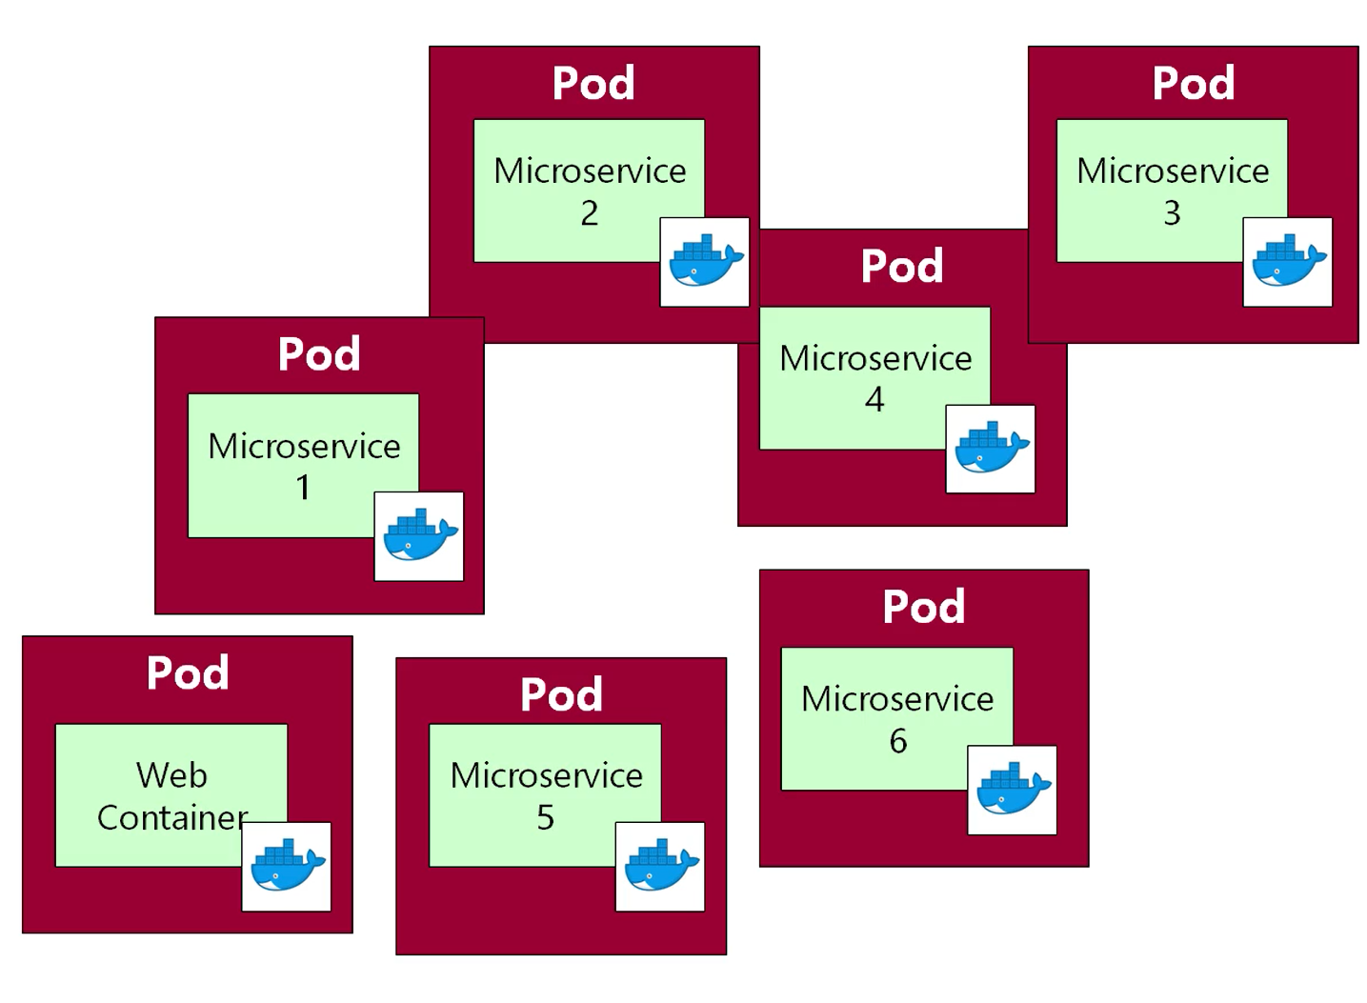
Notes:
Pods: you never are going to have in a real world application more than one microservice in a single Pod. It is one microservice for one Pod.

Slide 4
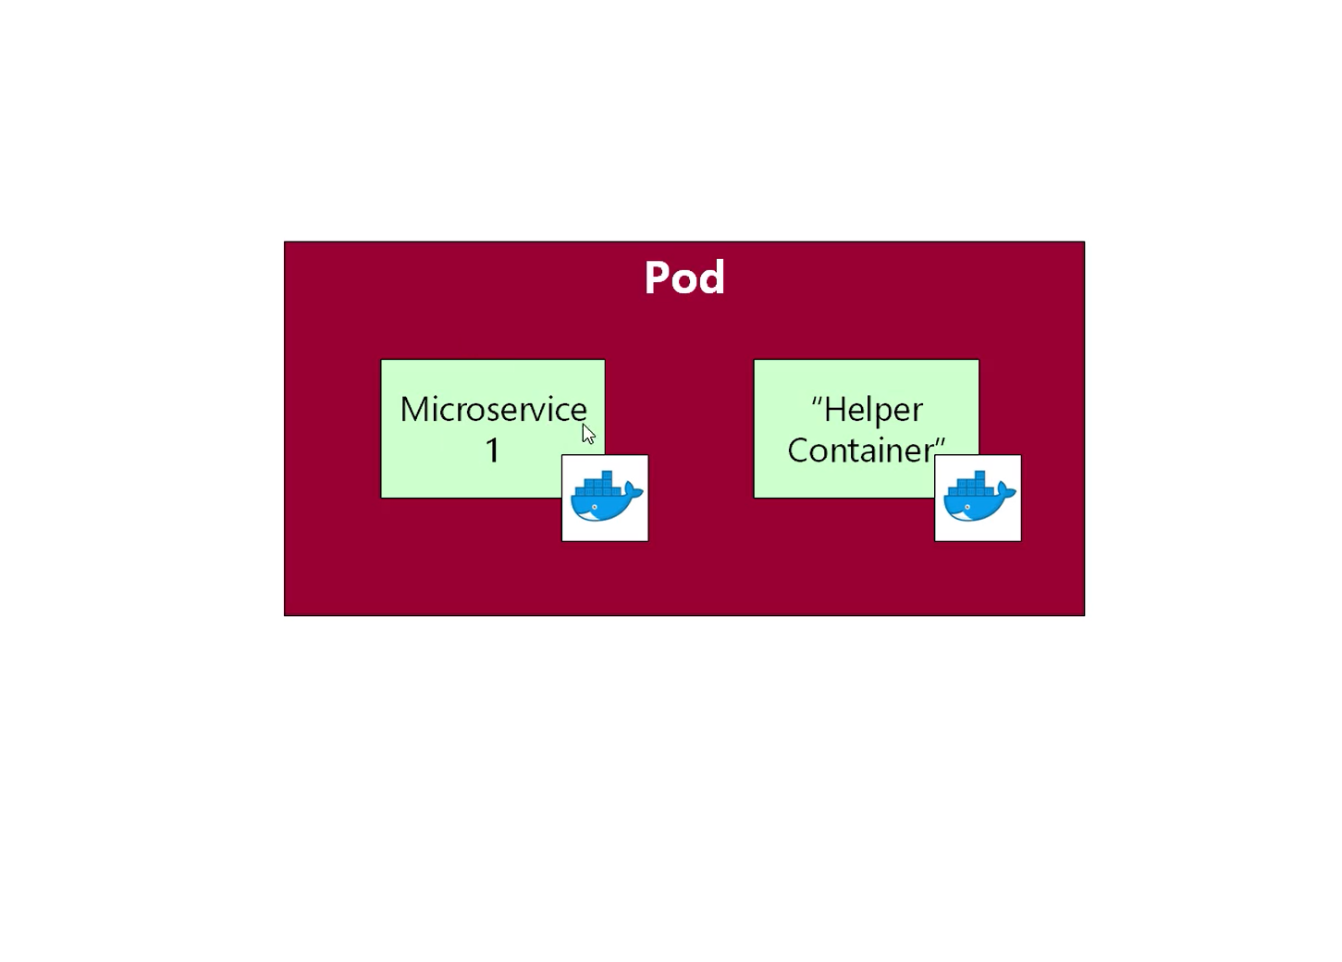
Weird Scenario
Notes:
Pods: you never are going to have in a real world application more than one microservice in a single Pod. It is one microservice for one Pod.

Slide 5
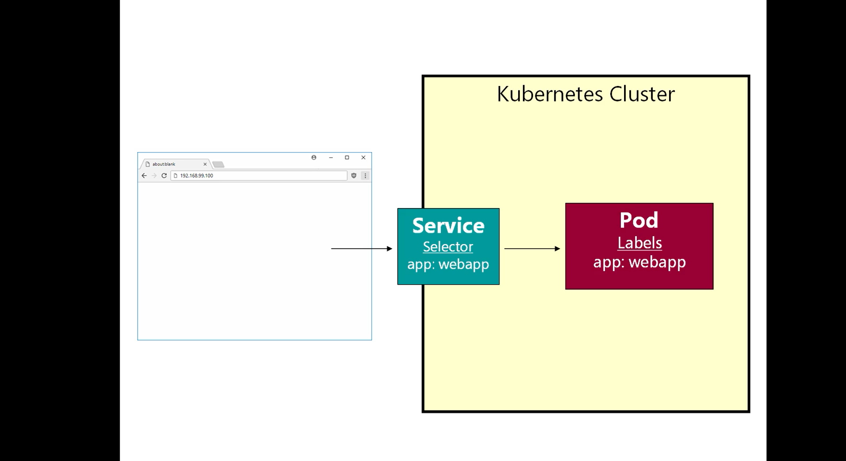
Notes:
A service is a long running object
It have an IP address
We can attach services to Pods
We connect Service to Pod to access our applications locally.
To connect Pod you should define it a Label, and in the Service you should define a Selector that searches for a Pod with a Label matching its Selector.

Slide 6
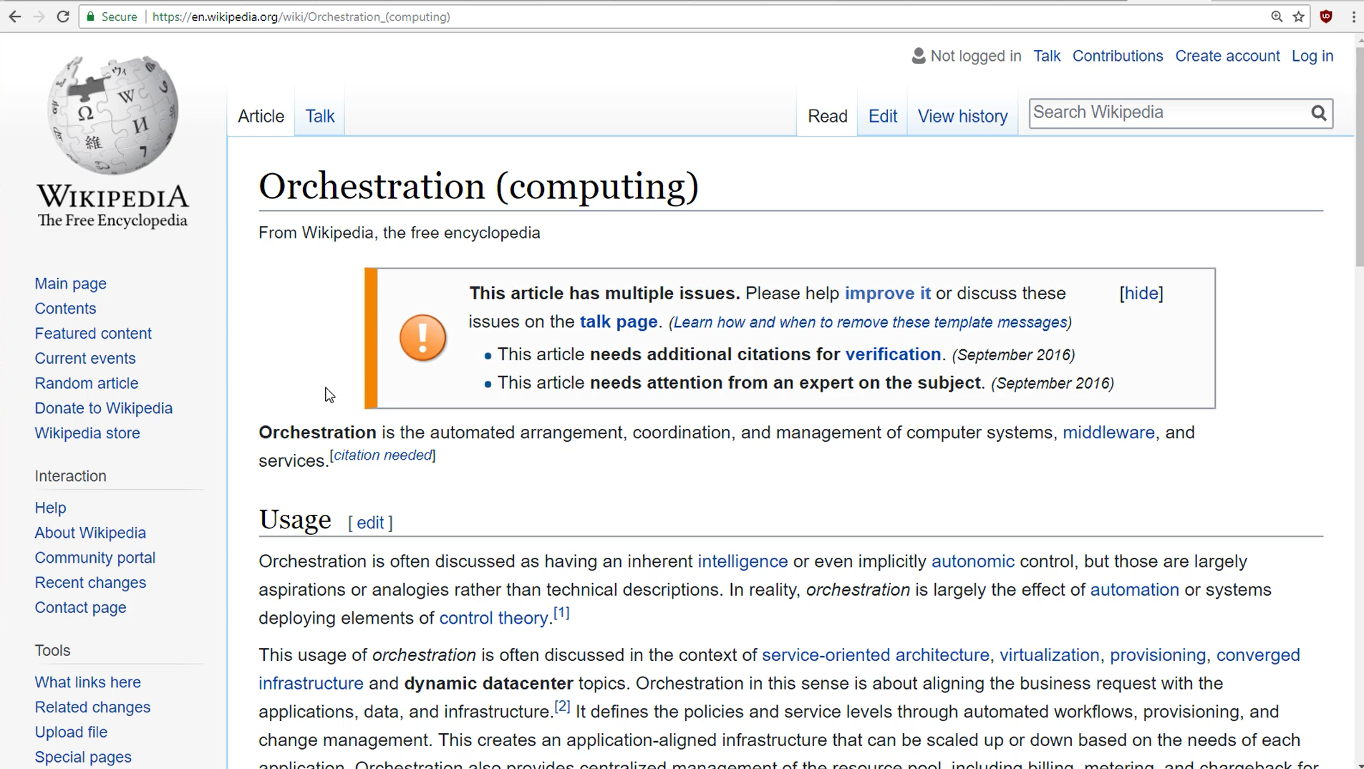

Slide 7
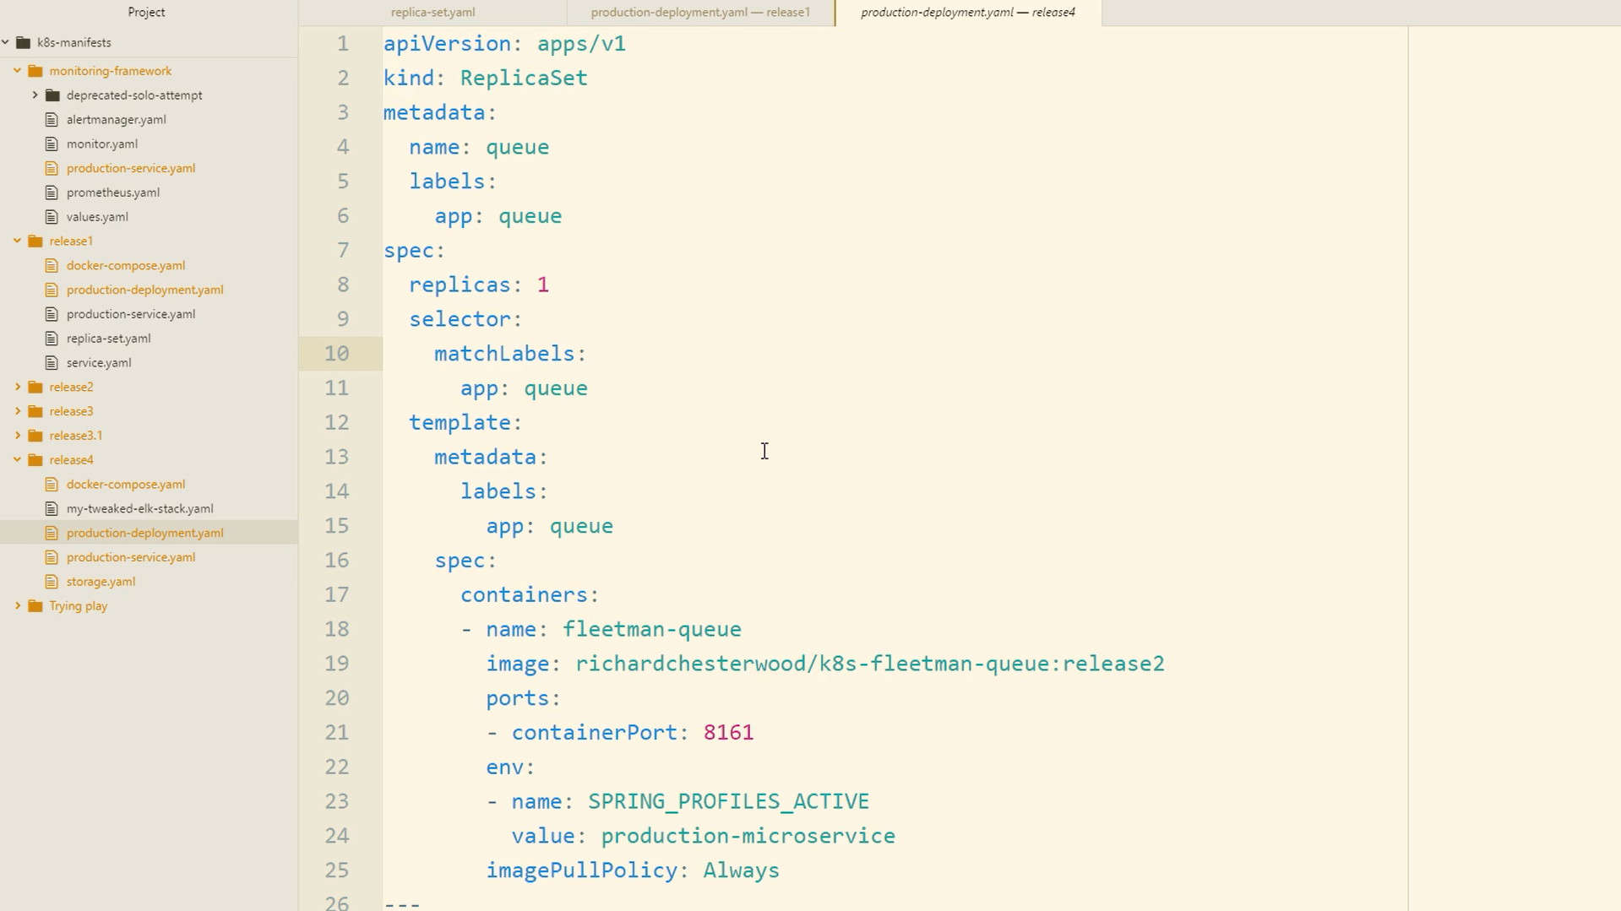

Slide 8
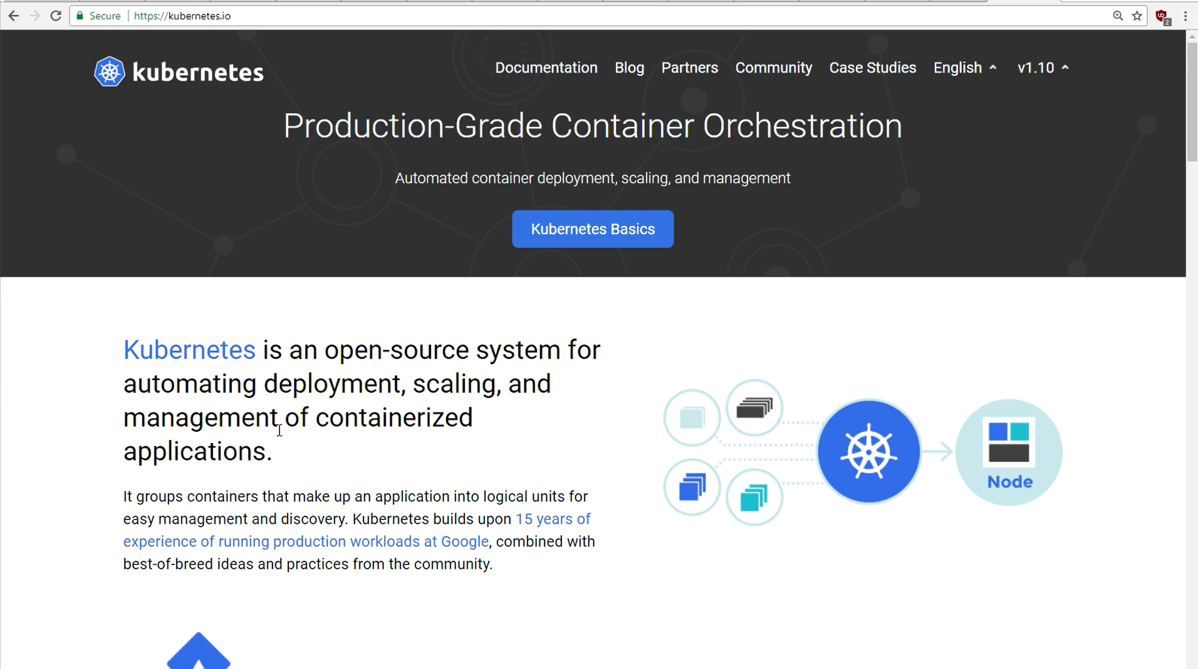

Slide 9
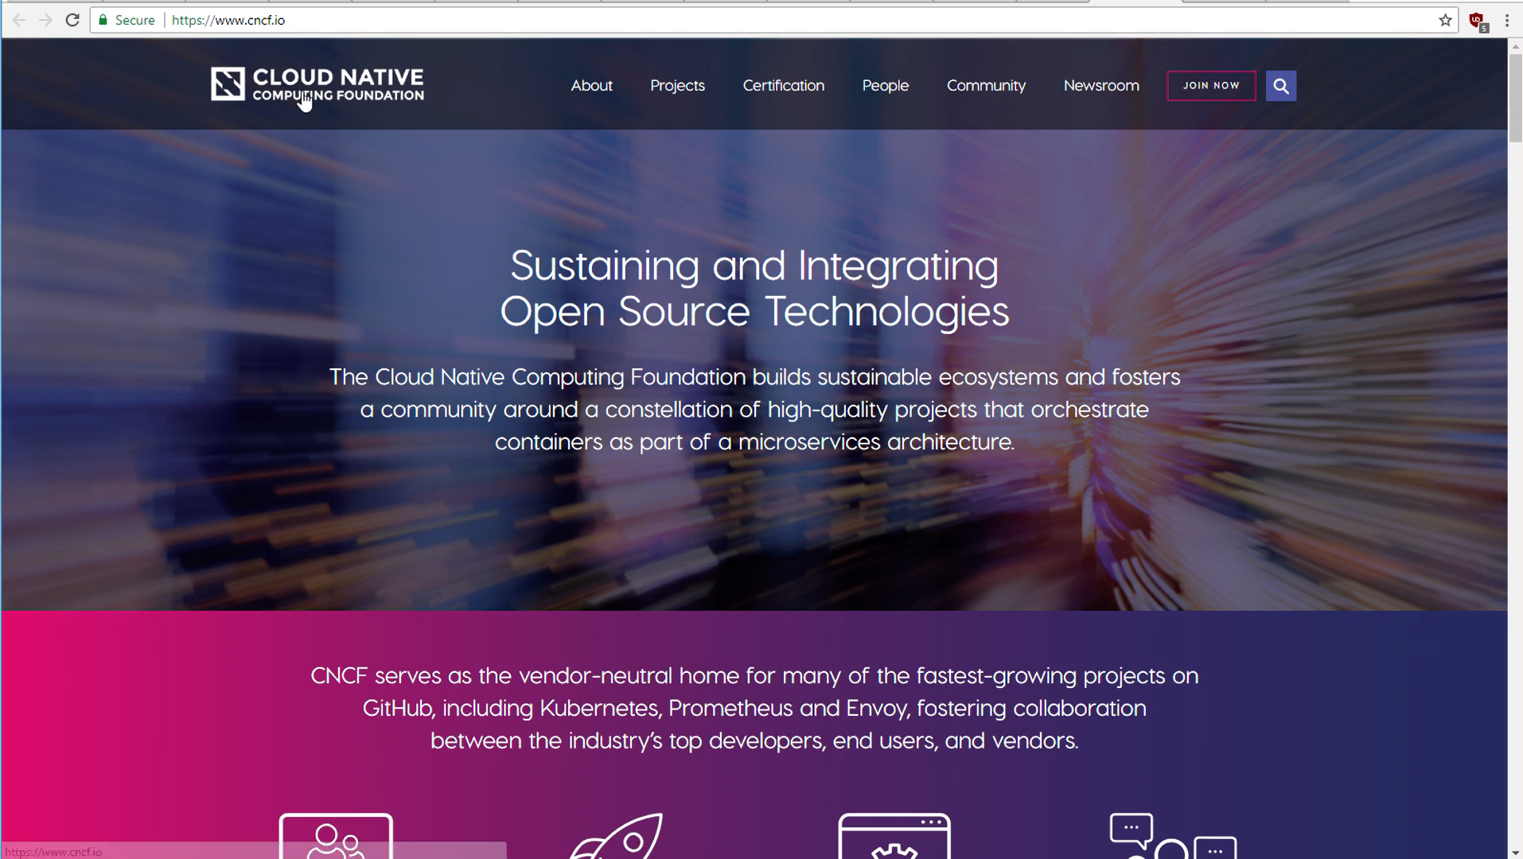

Slide 10
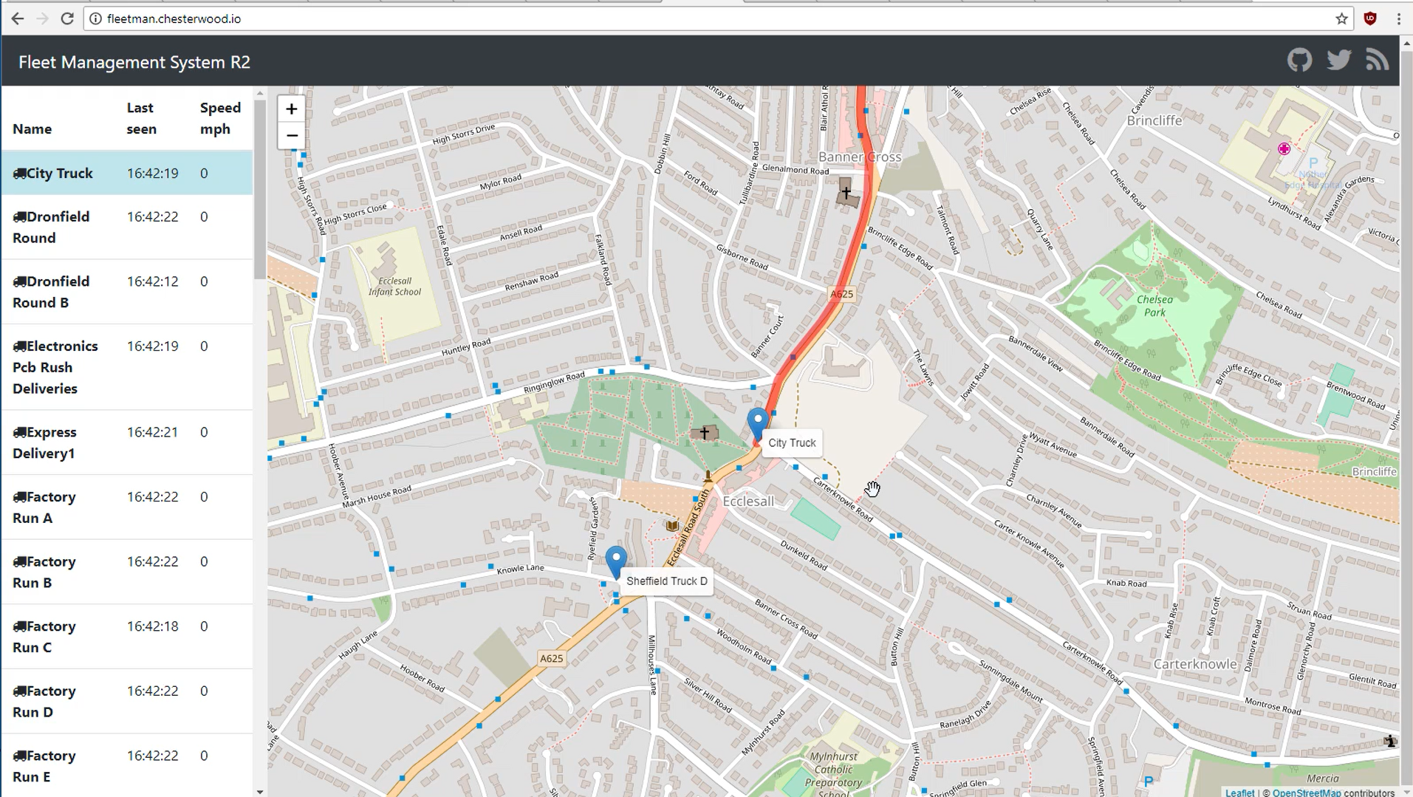

Slide 11
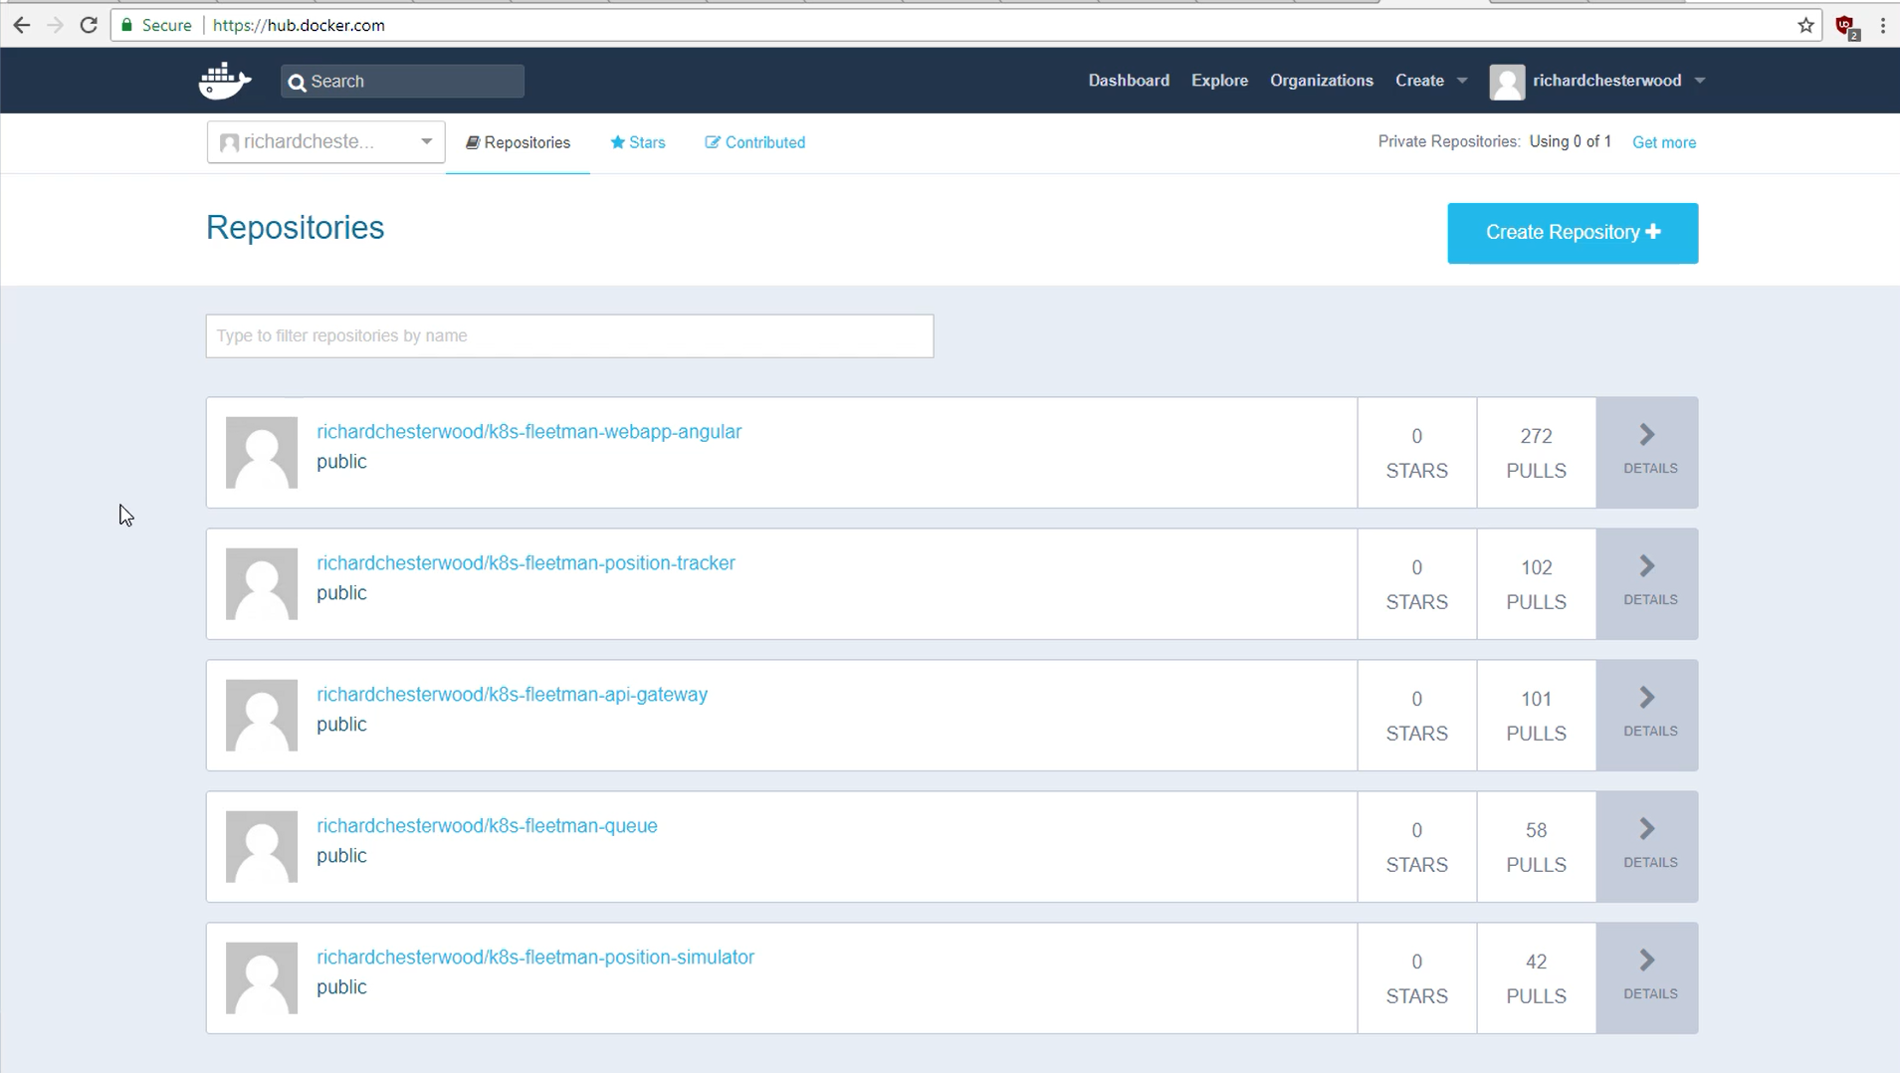

Slide 12
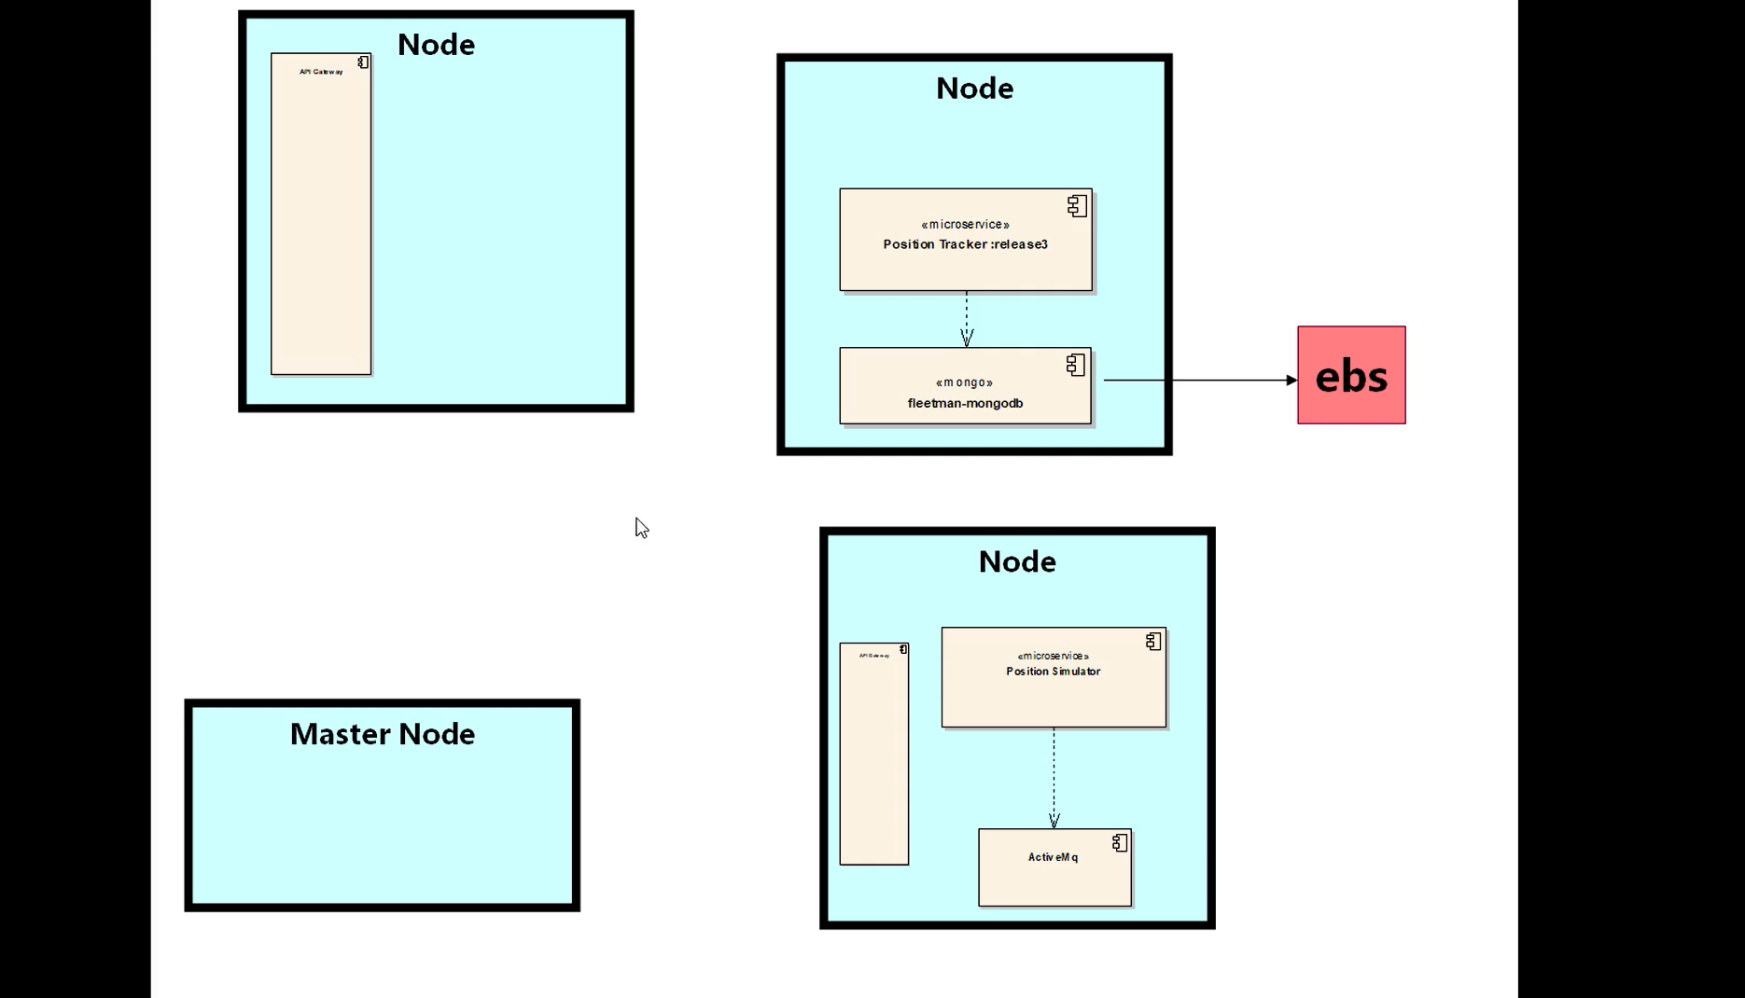

Slide 13
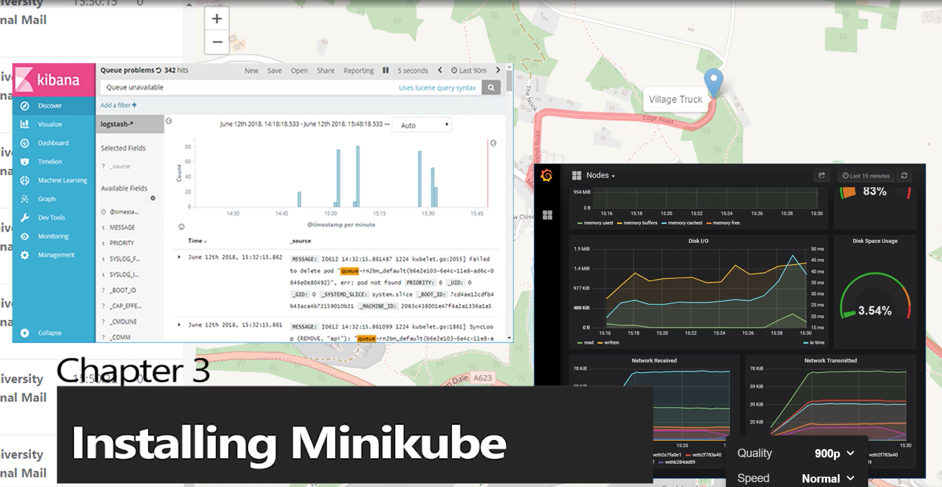

Slide 14
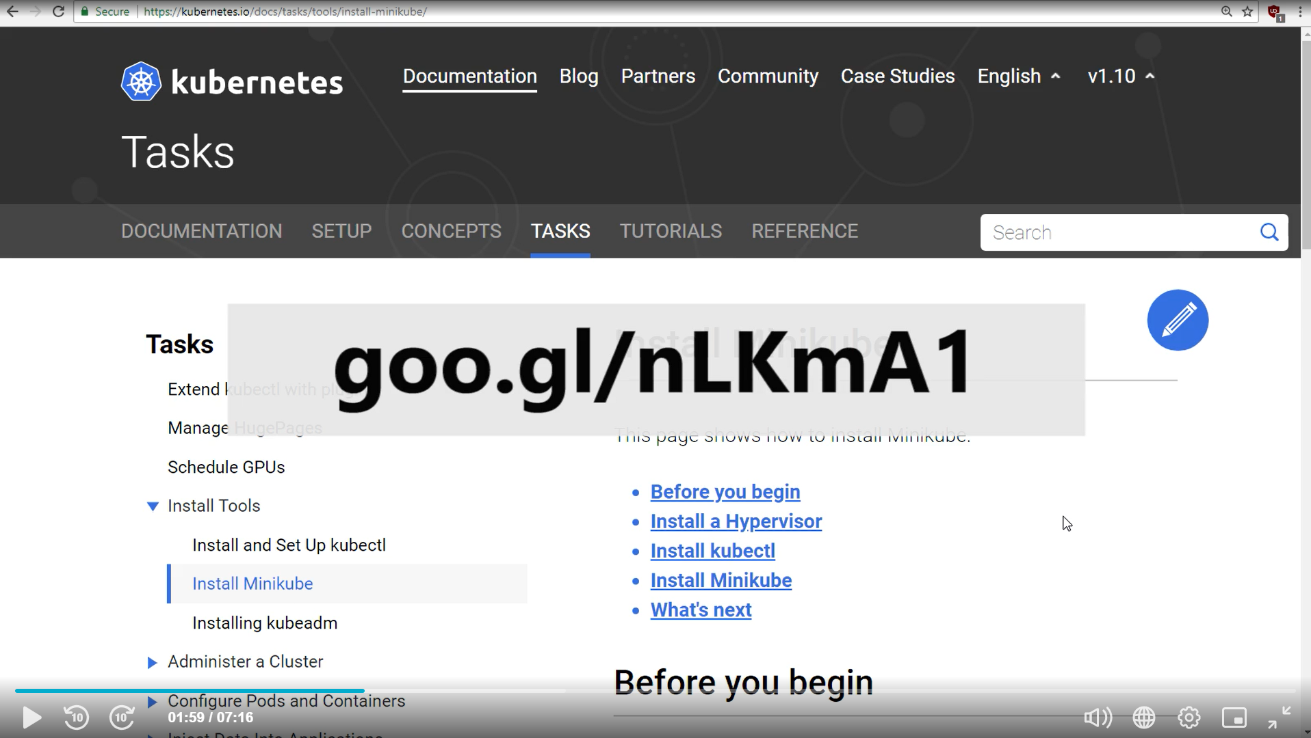

Slide 15
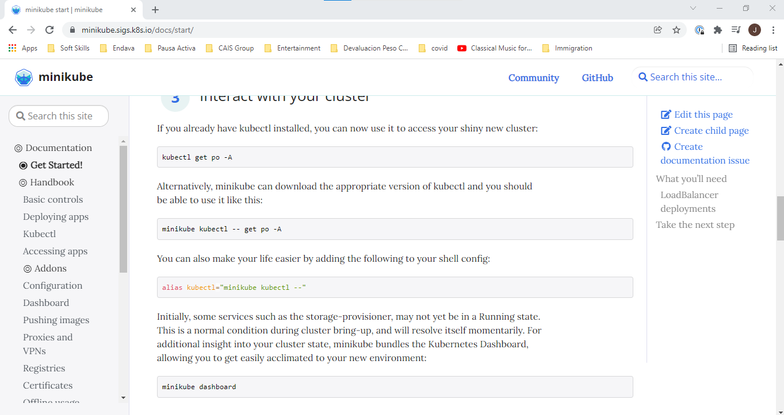

Slide 16
Kubernetes Desktop Tools
Kubectl: controller program for kubernetes
Minikube: slight versión of kubernetes for running in development computers

Slide 17
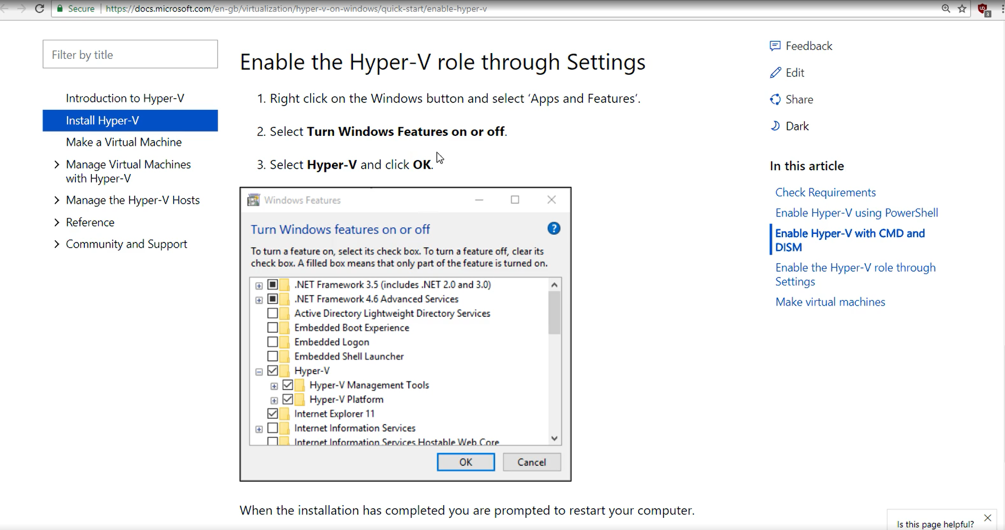

Slide 18
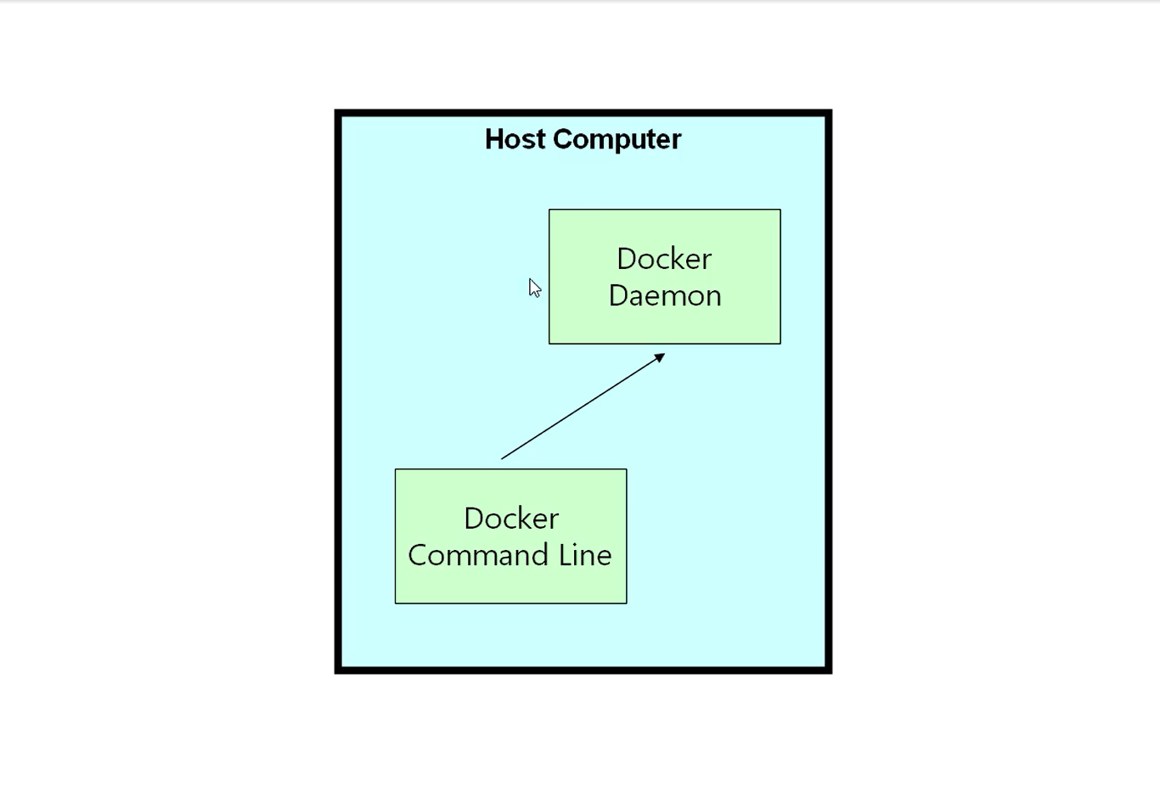

Slide 19
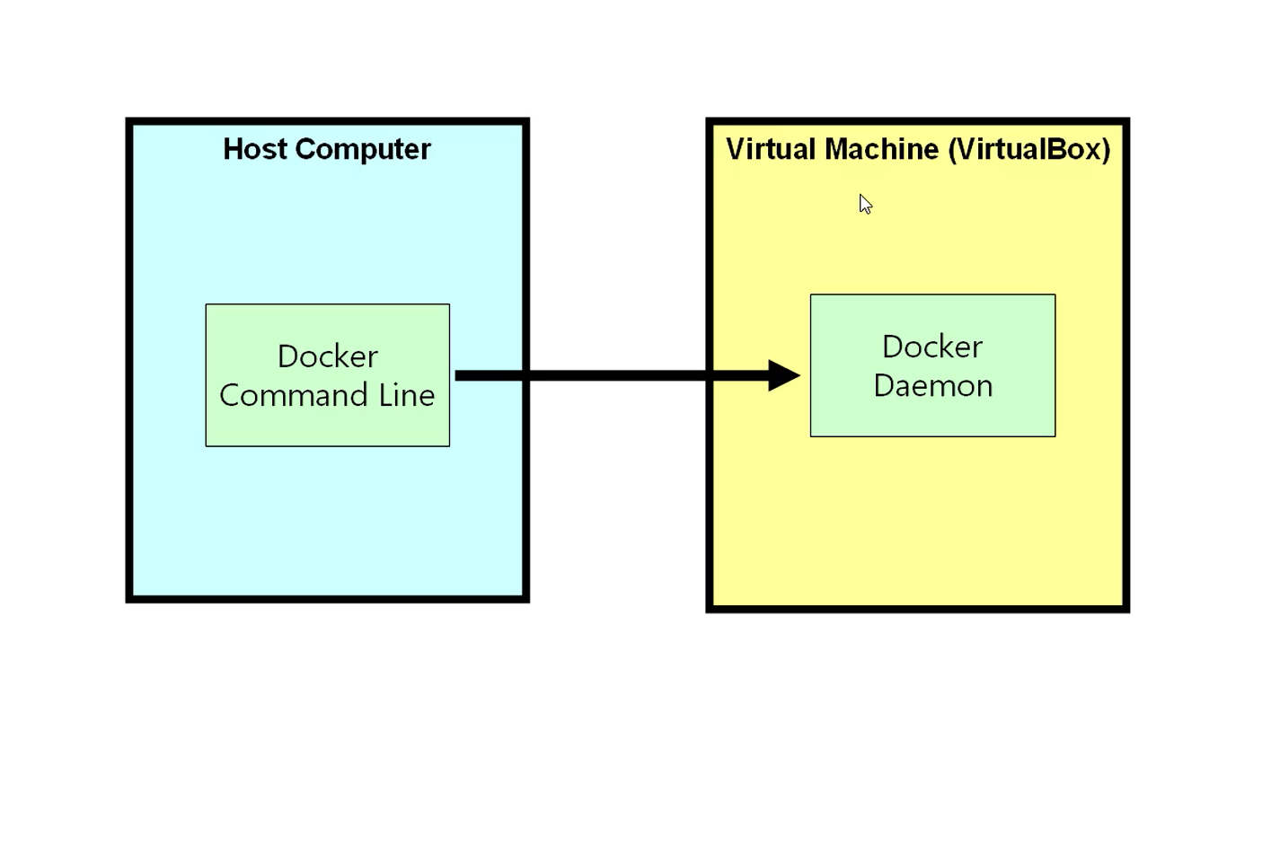

Slide 20
